Slide 1
COW
Name of the maker: ashish

Slide 2
Table of Contents
1. Introduction to Cows
2. Breeds of Cows
3. Anatomy of a Cow
4. Life Cycle of a Cow
5. Importance of Cows
6. Summary

Slide 3
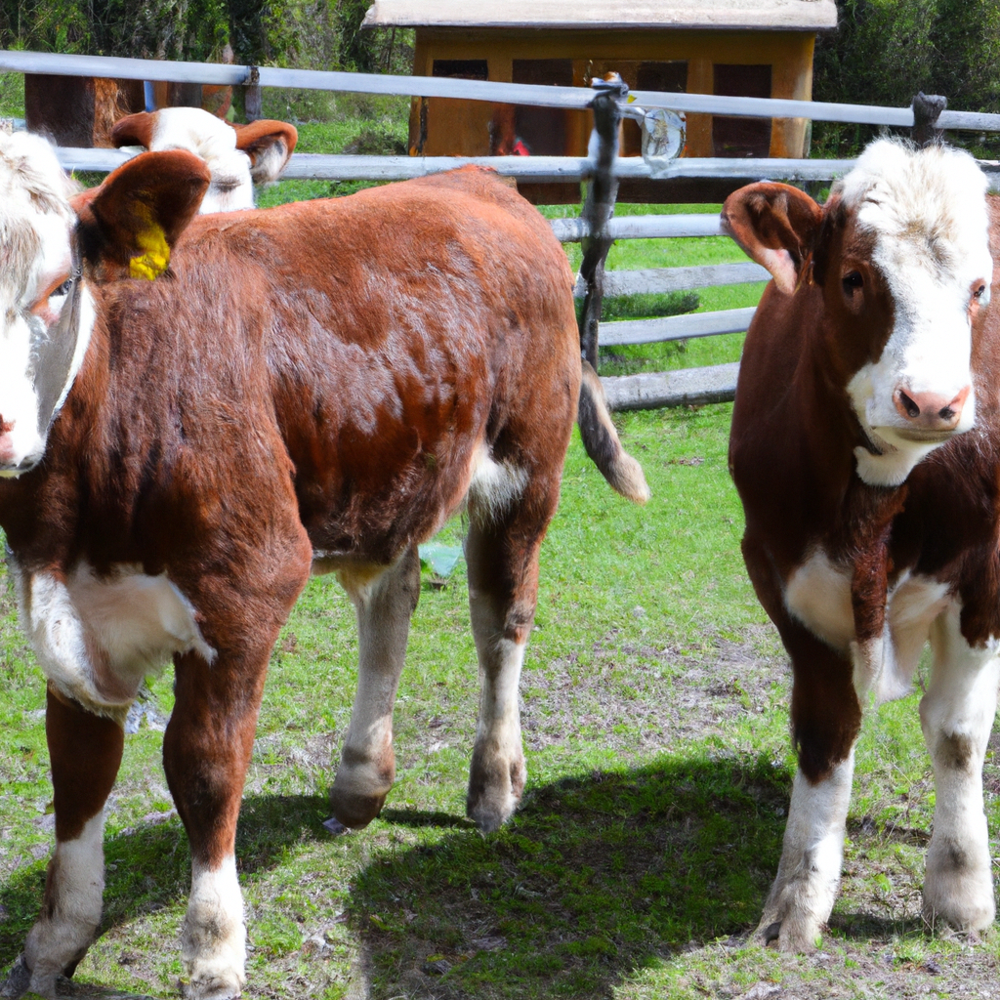
Introduction to Cows
Cows are domesticated animals that are primarily raised for their milk, meat, and leather. They are herbivores and are found all over the world. Cows are known for their gentle nature and are often referred to as "cattle."

Slide 4
Breeds of Cows
There are numerous breeds of cows, each with its own distinct characteristics. Some popular breeds include Holstein, Angus, Hereford, Jersey, and Brahman. These breeds vary in size, color, and milk production.

Slide 5
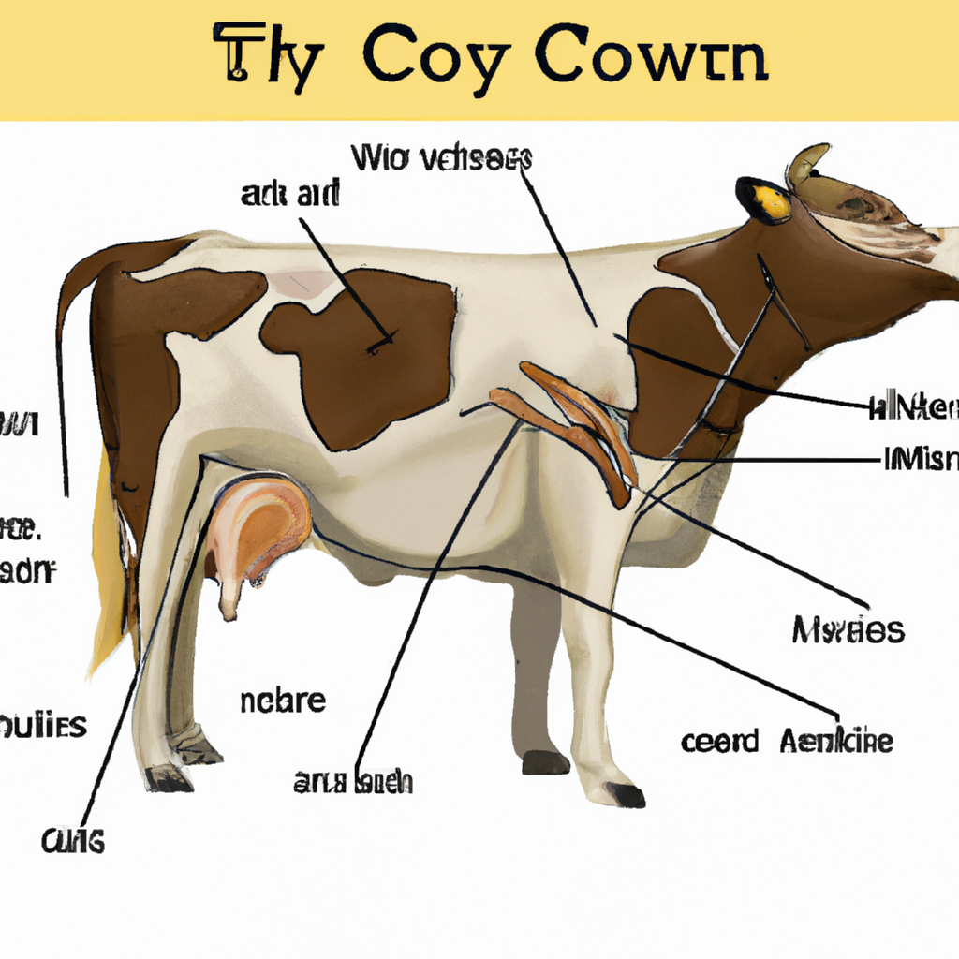
Anatomy of a Cow
Cows have a unique anatomy that allows them to efficiently digest plant material. They have a four-chambered stomach, which includes the rumen, reticulum, omasum, and abomasum. Cows also have a large udder for milk production.

Slide 6
Life Cycle of a Cow
A cow goes through various stages in its life cycle, starting as a calf and eventually becoming an adult cow. The female cows, called heifers, can start reproducing at around two years old. Cows have a gestation period of around nine months.

Slide 7
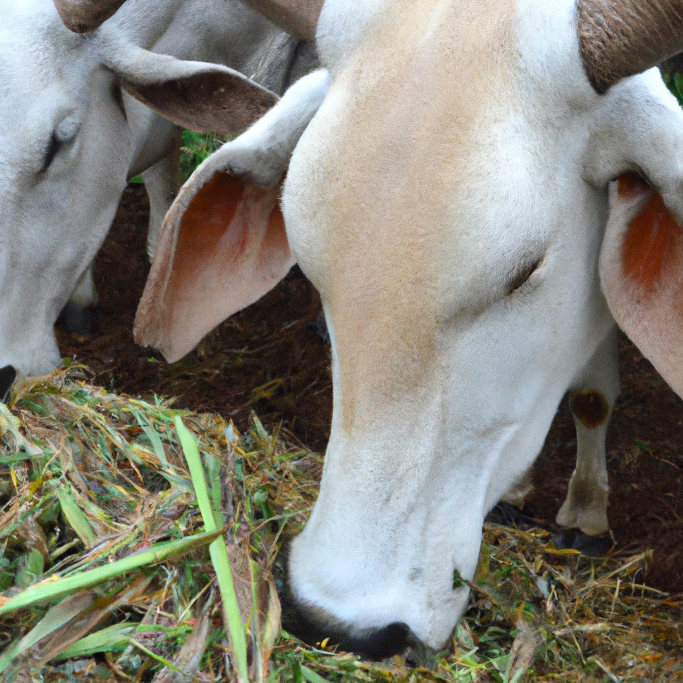
Importance of Cows
Cows play a crucial role in our society. They provide us with milk, meat, and leather, which are essential for our sustenance and various industries. Cows also contribute to the agricultural sector by providing manure for fertilizers.

Slide 8
Summary
Cows are domesticated animals that are raised for their milk, meat, and leather. They come in various breeds and have a unique anatomy. Cows go through different stages in their life cycle and are of great importance to our society.

